Slide 1

Agile Software Development (TCS 855)
Feature Driven development (FDM)
Prof.(Dr.) Santosh Kumar
Department of Computer Science and Engineering
Graphic Era Deemed to be University, Dehradun

Slide 2
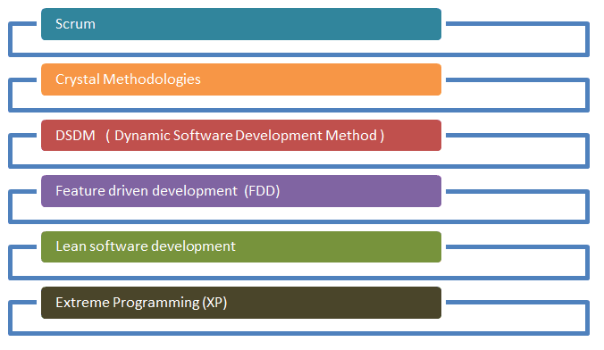
Agile Process Model
Figure: Agile Process Model

Slide 3
Feature Driven development (FDM)
Feature-Driven Development (FDD) is customer-centric, iterative, and incremental, with the goal of delivering tangible software results often and efficiently.
FDD in Agile encourages status reporting at all levels, which helps to track progress and results.
FDD allows teams to update the project regularly and identify errors quickly.
FDD is a favorite method among development teams because it helps reduce two known morale-killers in the development world: Confusion and rework.
FDD was developed and refined by Jeff De Luca, Peter Coad and others.
First applied in 1997 during a project for a Singapore bank,. The original project took 15 months with 50 people, and it worked; and second project was, 18-month long, 250-person project.

Slide 4
Since then, it’s become a pragmatic approach ideal for long-term, complex projects looking for a simple but comprehensive methodology.
While Scrum and new variations of Agile are more widely recognized methods.
FDD can be a good option for software development teams looking for a structured, focused Agile methodology that can be scaled across the product organization and will deliver clear outcomes.

Slide 5
How is FDD Different from Scrum?
FDD is related to Scrum, but as its name implies, it’s a feature-focused method (as opposed to a delivery-focused method).
Features are a foundational piece of FDD; they’re to FDD what user stories are to Scrum: Small functions that are, most importantly, client-valued.
“During FDD, a feature should be delivered every 2-10 days – which differs from Scrum, in which sprints typically last two, but sometimes four, weeks.”
FDD values documentation more than other methods (Scrum and XP included), which also creates differences in the roles of meetings.
In Scrum, teams typically meet on daily basis while in FDD, teams rely on documentation to communicate important information, and thus don’t usually meet as frequently.
Another key difference is the end user; in FDD, the actual user is viewed as the end user, whereas in Scrum it’s typically the Product Owner who is seen as the end user.

Slide 6
FDD Work
FDD ttypically used in large-scale development projects, five basic activities exist during FDD:
Develop overall model
Build feature list
Plan by feature
Design by feature
Build by feature
An overall model shape is formed during the first two steps, while the final three are repeated for each feature.
The majority (roughly 75%) of effort during FDD will be spent on the fourth and fifth steps – Design by Feature and Build by Feature.

Slide 7
“Teams using all Agile methodologies operate with the primary goal of quickly and effectively satisfying the needs of their customers; FDD is no exception.”
However, the difference is that once a goal has been identified, teams following FDD organize their activities by features, rather than by project milestones or other indicators of progress.

Slide 8
Stages of Feature-Driven Development
In FDD, each feature is useful and important to the client and results in something tangible to showcase. And because businesses appreciate quick results, the methodology depends on its two-week cycle.
Stage 0: Gather Data
As with all Agile methodologies, the first step in FDD is to gain an accurate understanding of content and context of the project, and to develop a clear, shared understanding of the target audience and their needs. During this time, teams should aim to learn everything they can about the why, the what, and the for whom about the project they’re about to begin (the next few steps will help clarify the how).
This data-gathering can be thought of as stage 0, but one that cannot be skipped.
Once teams have a clear understanding of their goals, the targeted audience and their current (and potentially, future) needs, the first named stage in FDD can begin: Developing an Overall Model.

Slide 9
Develop an overall model
Build a features list
Plan by Feature
Design by Feature
Build by Feature
Feature-Driven Development is a practical Agile approach suited for long-term, complex projects.
It is a suitable choice for development teams seeking a simple but structured Agile method that is scalable and delivers predictable results.

